Slide 1

Becoming a good and professional teacher by
M. Maghsoudi, Ph.D. in tefl assistance Professor, Farhangian University, Arak

Slide 2
Classroom management
Classroom management includes:
1- activities
a) kinds of activities
b) monitoring activities
c) timing activities
2- grouping and seating
3- authority
a) deciding who does what
b) holding attention
c) relinquishing authority

Slide 3
Classroom management
4- critical moments
Starting the lesson
Dealing with unexpected problems
Finishing the lesson
5- tools and techniques
Using the board and classroom equipments
using gestures
Appropriate volume and speed
Use of silence
Grading policy

Slide 4
Classroom management
6- working with students
Spreading your attention evenly
Eliciting feedback from students
Really listening to students
Understanding the students

Slide 5
Classroom management
Classroom Interaction:
In the list of statements below, choose any that you feel you agree with.
1.a. it is more important for learners to listen and speak to teachers than for learners to listen and speak to each other.
1.b. students should get most conversation practice in interacting with other learners rather than with teachers.
Commentary
If teachers speak most of the time, how much time will learners get to speak? Statement 1b suggests that we could maximize learners speaking time.

Slide 6
Classroom management
2.a. students usually learn best by listening to people explaining things.
2.b. students usually learn best by trying things out.
Commentary
Explanation, especially long ones, tend to leave the students cold, get bored, switched off. They will have a problem to follow what is being said. But they learn effectively if they are involved, take risks, experiment and practice.

Slide 7
Classroom management
How could you get more student- student interaction instead of teacher to student or student to teacher ones?
Commentary
1- Encourage a friendly, relaxed, positive, supportive, rapport and trusting learning environment.
2- ask question rather than giving explanation.
3- allow time for students to listen, think and process their answer and speak.
4- use gesture to replace TT.
5- increase chances for STT.
6- if a student is speaking too quietly for you to hear, walk further away, rather than closer to them.

Slide 8
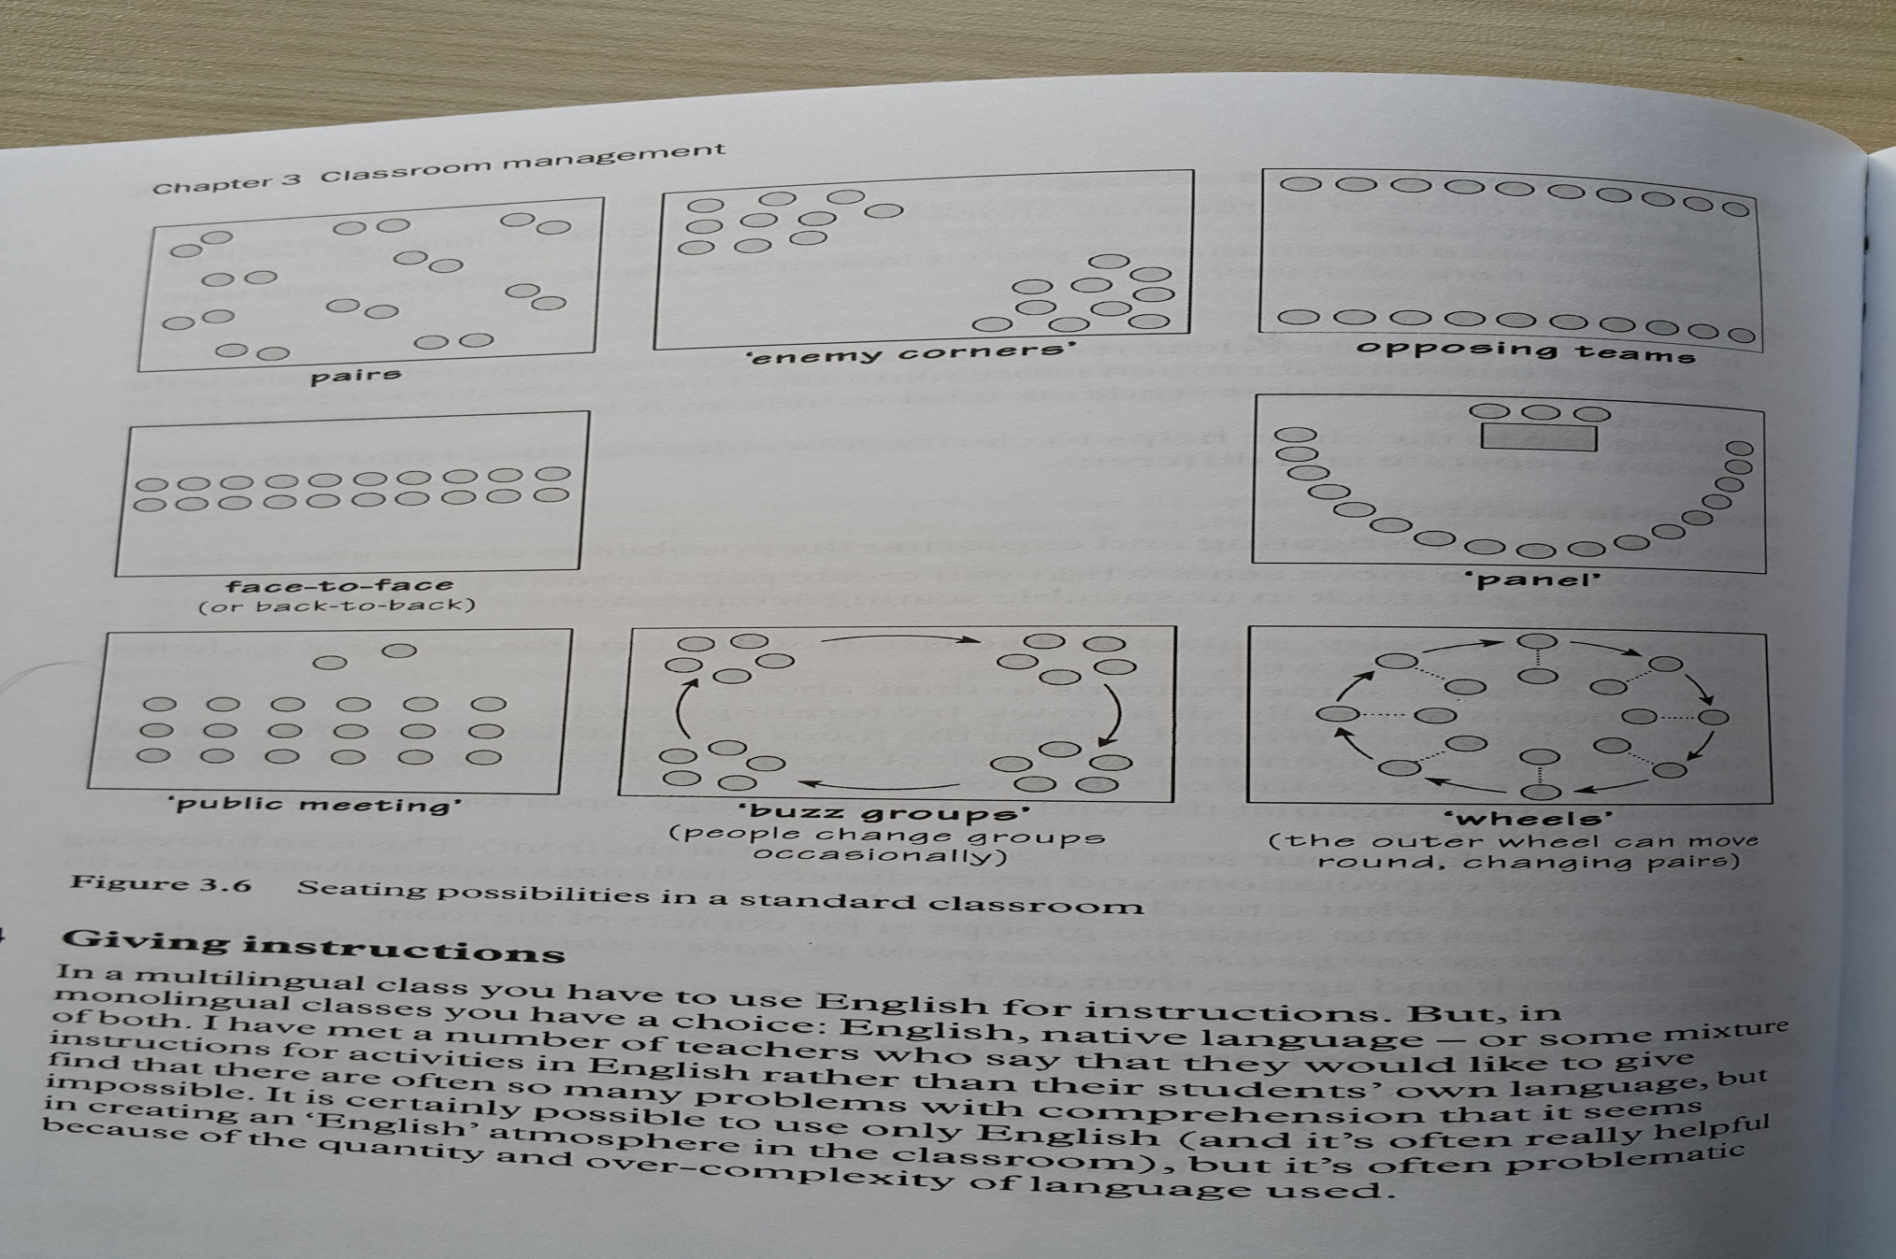
Classroom management
Seating options in the classroom

Slide 9
Classroom management
Kinds of Monitoring:
1- Monitoring to check the mechanics
2- Discreetly monitoring
3- Vanish
4- Actively monitoring
5- Participate

Slide 10
Classroom management
How to prevent learning? (unintentionally)
TTT
Echo
Adding tails to sentences
Asking “ do you understand?”
Over- politeness
Over- helping
Flying with fastest

